Slide 1
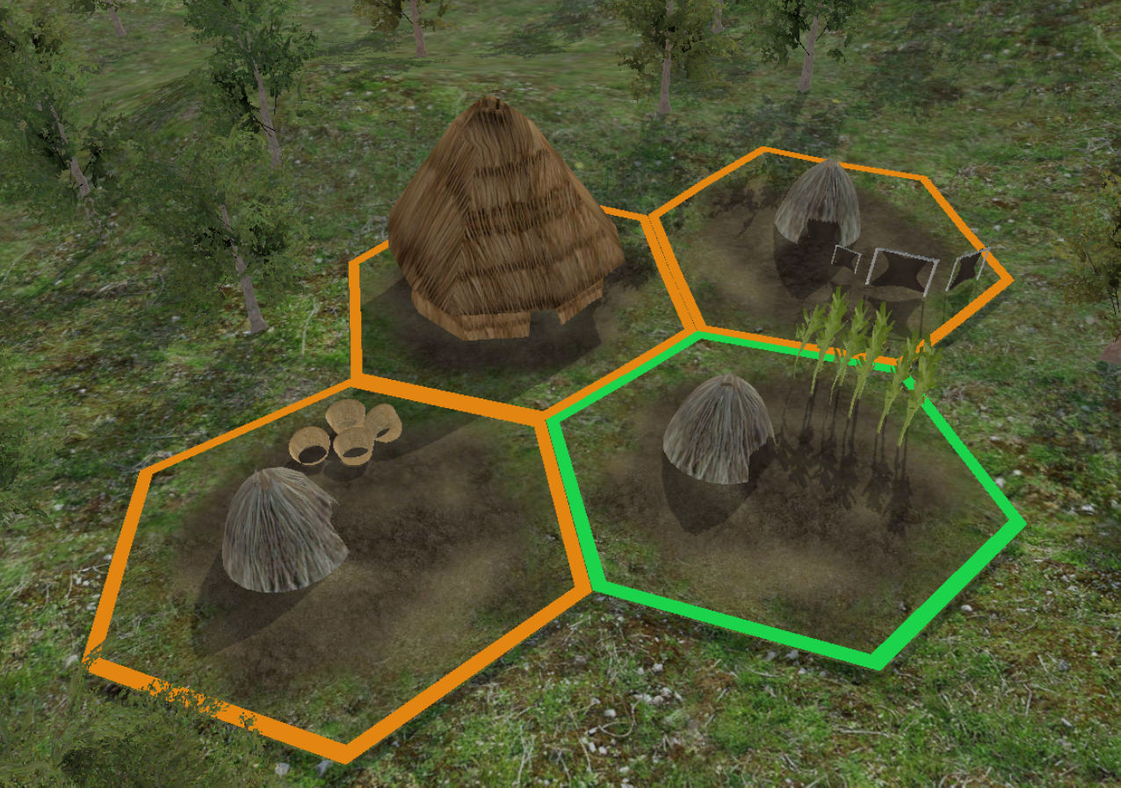

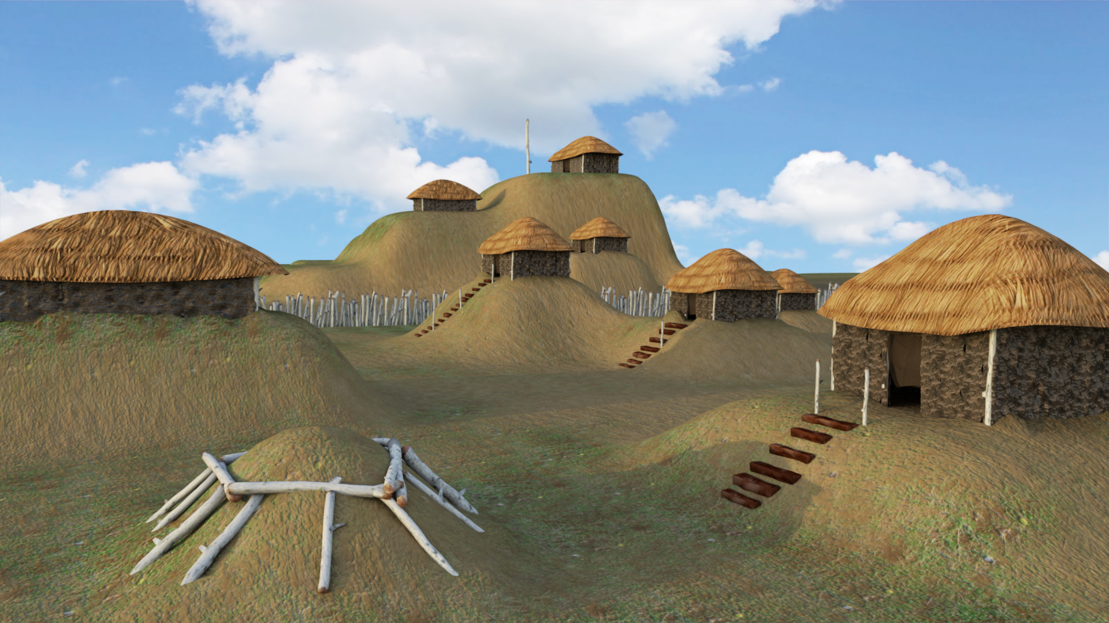
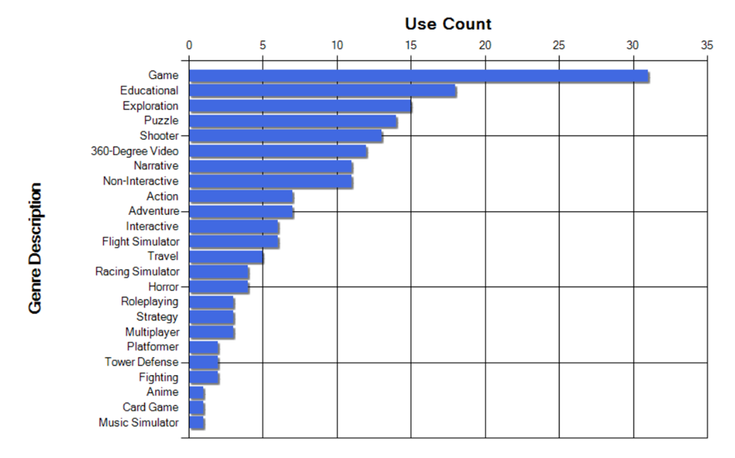
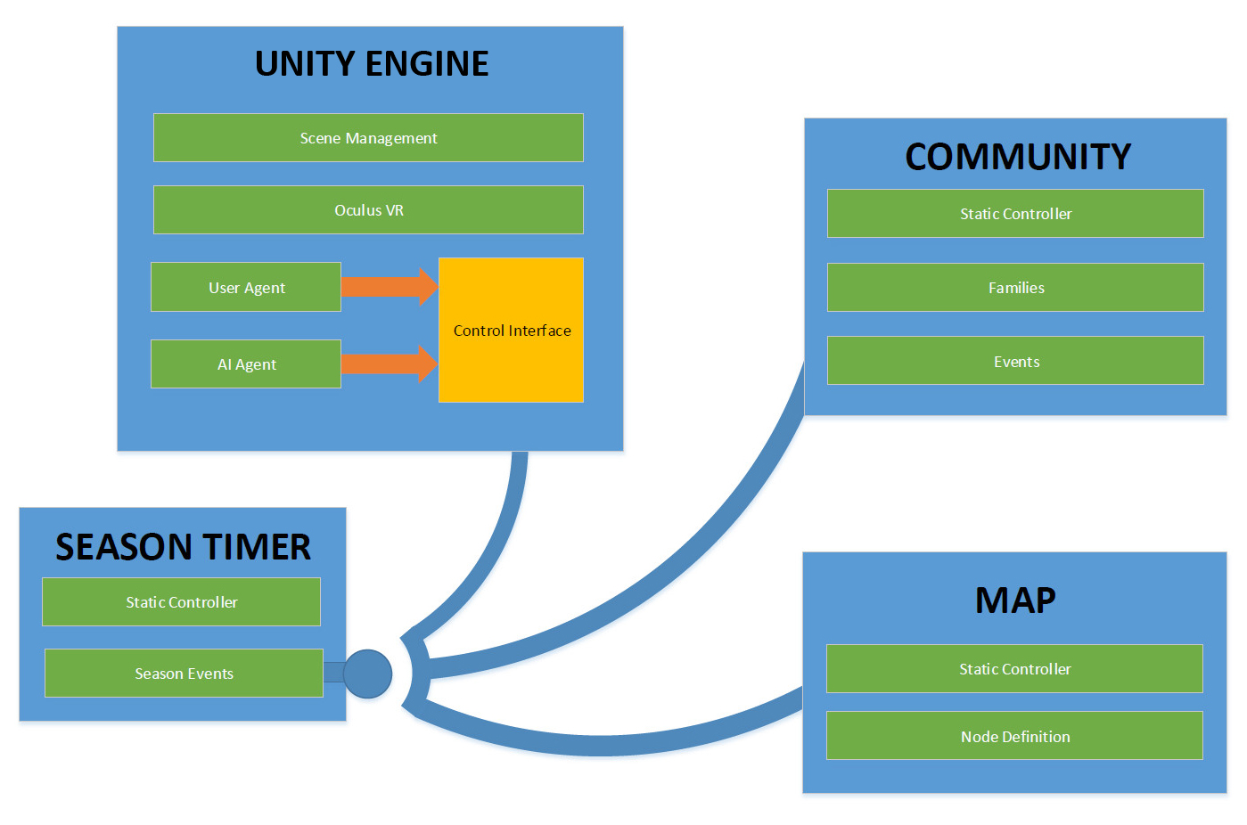
VR Application Research & Design
Daniel Johnson | Asad Ashur | T. Avery Eich -- Department of Computer Science
Dr. Aleshia Hayes, Advisor
RESEARCH
DESIGN
PROTOTYPE
Vision
Genre & Mechanics
Advanced Virtual Reality technology and tools have become accessible to even small, independent teams of engineers and artists. Highly detailed visual simulations and interactive systems can now be realized with great support. In light of these advancements, this project provided the team a unique opportunity to research creative applications to software development, and utilize that research to design a unique experience.
The team chose to utilize the following genres to incorporate into the design: Educational, Simulation, Strategy, and Game. These genres were well-placed for the VR platform, and also provided a synergy between the following mechanics: 360-degree View, Item Use, and Static User Interface.
A prototype system was developed using the Unity Game Engine, and tested on a mobile VR device (Samsung Gear VR). Focus was placed on creating a real time simulation that included turn-based, “seasonal” events. Cultural details were researched and included in a tribal community, family units, and economic activities, while a dynamic map structure was created to track the placement and state of game elements.
Method
In order to analyze and visualize data on current VR trends, existing applications were reviewed and findings collected into a relational database using a custom-built desktop application. This application provided basic data entry and reporting features to properly organize and present information.
Conceptual 3D Render
Progression
Architecture
Results
The mixture of these genres and mechanics directed the design of a real time strategy, cultural simulation experience inspired by the North American, Mississippian cultural period (“Mound Builders”). A complex system of resource gathering and asset production was defined and documented.
The system was designed to be offered as a cultural simulation that would progress without any user interaction using randomly generated events and basic AI decision-making. However, a user is given the choice of observing the community at various levels, or even participating it economic activities such as hunting, gathering, or farming.
The results effectively determined genres and mechanics that trended to succeed on the VR platform. Analysis also determined what key genres and mechanics might be combined with the goal of providing a more robust VR experience.
Conclusion
Our team discovered that Virtual Reality application design and development is a new frontier that has a mysterious future. The technology holds great potential for use in entertainment, education and job training. This project granted team members valuable insight into unique system design and collaboration between software engineering and visual communication.
“Genres used among VR applications.”
Application Architecture – (Unity Game Engine)

